Slide 1
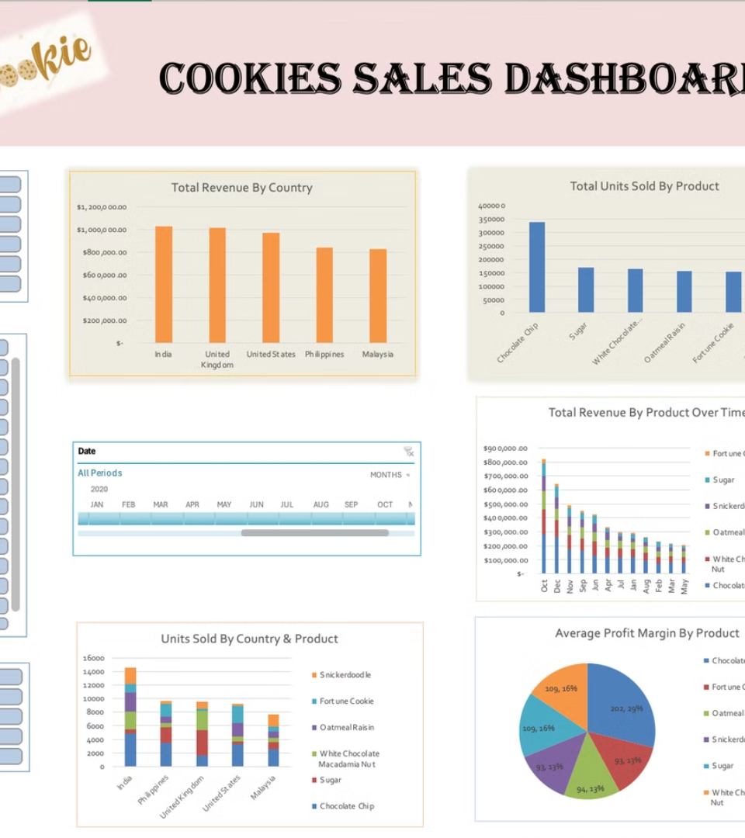
Building an Interactive Dashboard Using Excel
This presentation outlines the steps to create an interactive dashboard in Excel. We will cover data cleaning, pivot table creation, slicer implementation, timeline integration, and chart visualization. The goal is to provide a comprehensive guide for building dynamic and insightful dashboards.
YR
by Youhem Rouainia

Slide 2
Data Cleaning Process
Data Preparation
Data Refinement
Begin by removing unnecessary rows and columns to streamline the dataset. Standardize text formatting for consistency and handle missing data appropriately. Correct any incorrect data types to ensure accurate analysis.
Eliminate duplicate entries to avoid skewed results. Add calculated columns such as Profit Margin and Revenue for enhanced insights. Format dates and numbers for clarity and save a cleaned copy of the dataset for future use.

Slide 3

Creating Pivot Tables
1
Revenue by Country
2
Units Sold by Product
Overview of total revenue generated by each country.
Number of units sold for each product.
3
Profit Margin by Product
4
Revenue by Product Over Time
Profitability of each product.
Tracks revenue changes for each product over time.

Slide 4



Adding Interactivity
Slicers
Timeline
Insert Slicers for Country and Product to dynamically filter pivot tables.
Insert a Timeline based on the Date column to filter data by specific months or years, enabling trend analysis.

Slide 5
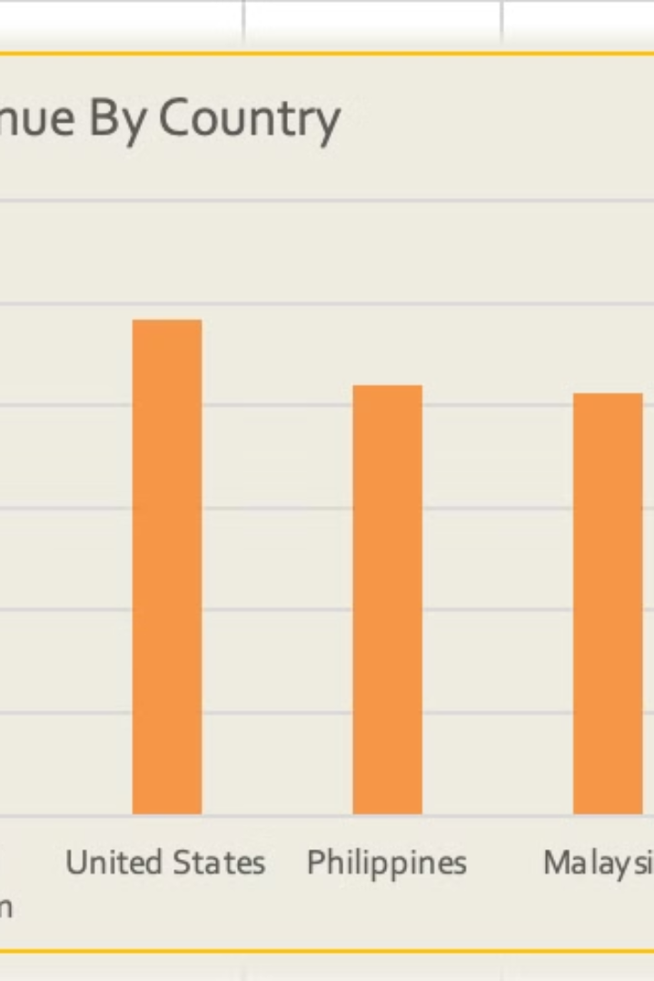



Visualizing Revenue by Country
Bar Chart
Create a Bar Chart from Pivot Table 1 to visualize total revenue generated by each country.
Insights
Highlights which countries contribute the most to total revenue.
Recommendations
Allocate more resources to high-performing markets.

Slide 6



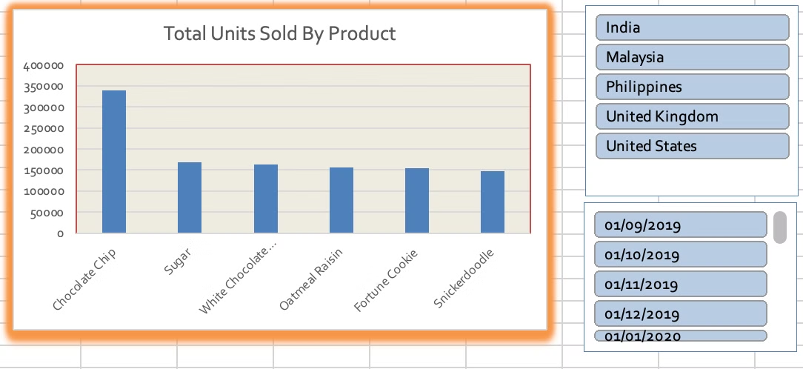
Visualizing Units Sold by Product
2
Insights
Shows which products are the most popular in terms of units sold.
Column Chart
1
Create a Column Chart from Pivot Table 2 to visualize the total units sold for each product.
Recommendations
3
Increase marketing efforts for top-performing products.

Slide 7



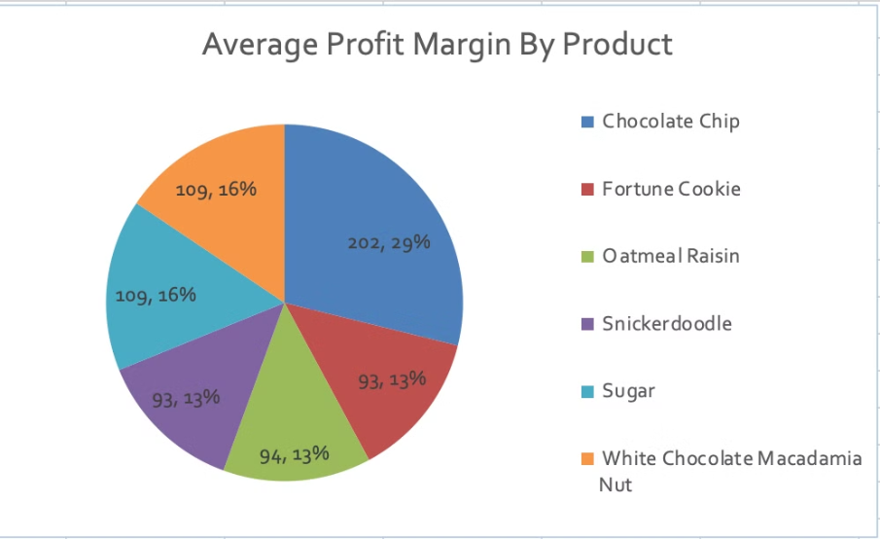
Visualizing Profit Margin by Product
1
Pie Chart
Insights
2
The pie chart reveals which products contribute the most to profitability.
Some products may have high sales volumes but low profit margins, while others may have fewer sales but higher margins.
Recommendations
3
Optimize Pricing Strategy: For products with low profit margins, consider adjusting costs (e.g., sourcing cheaper materials) or increasing prices if market conditions allow.
Use Pivot Table 3 to create a Pie Chart that illustrates the profit margin percentages for each product. The pie chart reveals which products contribute the most to profitability. For products with low profit margins, consider adjusting costs or increasing prices if market conditions allow.

Slide 8
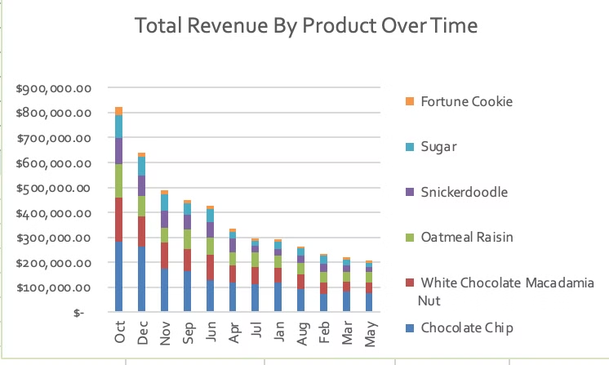
Visualizing Revenue by Product Over Time
Stacked Bar Chart
1
This stacked bar chart tracks how revenue for each product changes over time, helping identify seasonal trends, growth patterns, or declining performance. If certain products show spikes during specific months, plan targeted campaigns around those periods.
2
Insights
This stacked bar chart tracks how revenue for each product changes over time, helping identify seasonal trends, growth patterns, or declining performance.
Recommendations
Leverage Seasonal Trends: If certain products show spikes during specific months, plan targeted campaigns around those periods.
3
Address Declining Products: Investigate products with declining revenue trends. Are they losing relevance? Should they be updated or replaced?
Long-Term Growth Strategy: Focus on products showing consistent upward trends and allocate additional resources to scale their success.

